Slide 1

Skin Aid – A Skin Disease Classifier
Umesh Phulare – 24206002
Ved Sawant – 24206001
Pranay Bhere – 24206007 Vinay Patil – 23106072
Project Guide
Ms. Priyanka Patil
Notes:
1

Slide 2
Introduction
Skin diseases are among the most common health conditions worldwide, yet access to timely dermatological consultation is limited, especially in rural or underserved areas.
SkinAid is a platform designed to detect and classify skin diseases from user-uploaded images.
With a focus on accessibility, explainability, and accuracy, the system provides a digital dermatological screening tool that can assist patients, doctors, and health workers alike.
Notes:
2

Slide 3
Introduction
Objective:
Build an AI system to classify skin diseases from images with high accuracy.
Ensure accessibility, transparency, and early screening to improve patient outcomes.
Purpose:
Provide affordable, user-friendly dermatological screening.
Assist users in understanding potential skin conditions before visiting a specialist.
Notes:
3

Slide 4
Literature Survey of the Existing Systems
Title | Key Points | Improvements Proposed | Citation
"Dermatologist-level classification of skin cancer with deep neural networks" | High accuracy on par with dermatologists; proof-of-concept for AI in dermatology. | Focus on explainability and transparency for user trust and clinical adoption." | [1]
"Explainable deep learning model for skin lesion classification." | CNN outperforms most dermatologists in melanoma detection; high sensitivity. | Enhance interpretability to build confidence and act as a reliable second opinion. | [2]
"Deep learning for skin lesion analysis: The ISIC 2016 challenge." | Created large, standardized datasets; showed deep learning's high performance...." | Address real-world data variability beyond controlled datasets; handle diverse skin tones.adoption. | [3]
" A comprehensive review on machine learning-based skin cancer detection." | Highlights common pitfalls: data bias, need for large datasets, and ground truth. | Integrate explainability directly into a user-facing product for non-expert users. | [4]
"Towards a clinical skin imaging benchmark.". | Highlights common pitfalls: data bias, need for large datasets, and ground truth. | Develop a full, end-to-end user pipeline from image capture to actionable output. | [5]

Slide 5
Limitations of Existing Systems
Title | Key Findings
Early Stages (Pre-1900s) | Labor-intensive, requiring human experts to define rules. Seen as a Curse No awareness, and often practice some religion rituals
In-person consultation (1900- present) | Limited by geographic location. appointment availability, cost of a visit.
Machine Learning (2010-2020) | Still required manual feature engineering. Struggled to generalize to complex, unseen data. Accuracy was directly tied to the quality of handcrafted features.
Deep Learning & Modern AI (2020-present) | Early models lacked explainability, creating a trust barrier with healthcare professionals. Reliance on large, labeled datasets for training.

Slide 6
Problem statement
Consulting dermatologists for skin issues can be time-consuming, expensive, or delayed due to long appointment wait times. This often results in users ignoring or misjudging visible symptoms, leading to late or incorrect treatment.
There's a growing need for a user-friendly, AI-powered system that offers preliminary skin disease analysis, builds confidence with explainable results, and encourages timely medical follow-up when necessary.

Slide 7

Mapped Sustainable Development Goals (SDG)
Contributes to SDG 11 by making urban transport safer and more resilient.
SDG Goal Number | Title | Our Contribution
Goal 3 | Ensure healthy lives and promote well-being for all at all ages | Our SkinAid project directly supports SDG 3: by promoting the early detection of serious skin diseases like cancer and democratizing access to health information for everyone.

Slide 8
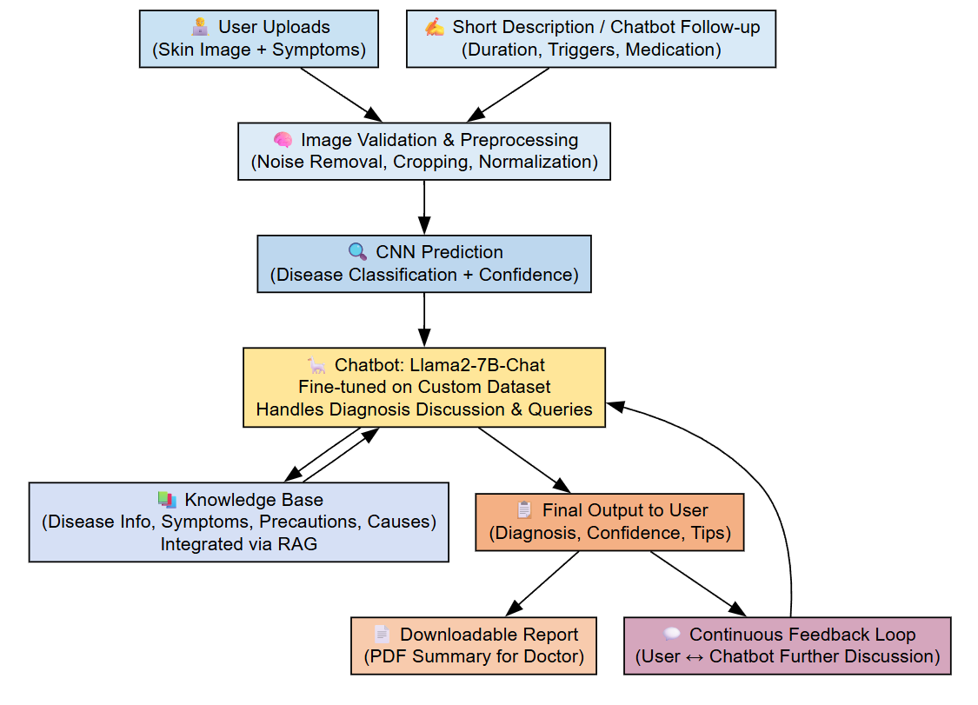
Overview of System Design
Notes:
8

Slide 9
To classify skin diseases from input images.
Technology Stack
Frontend: React For building a responsive UI or quick model interface.
Backend API: FastAPI To handle communication between frontend and ML model.
ML Framework: CNN (Convolutional Neural Networks) To classify skin diseases from input images.
Dataset: DermNet
To train the CNN based image classification model
Database: Firebase Will store user data and prediction history.
Server: Nvidia DGX Server
We have used Nvidia DGX Server for Training the chatbot.
Notes:
9

Slide 10
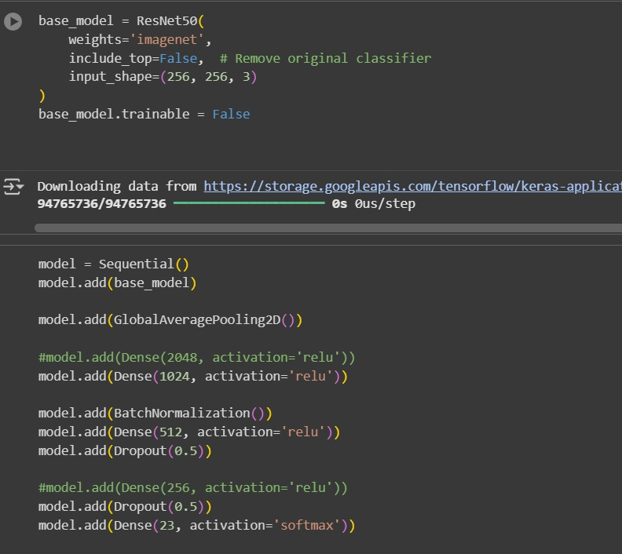
To classify skin diseases from input images.
Implementation
Notes:
10

Slide 11
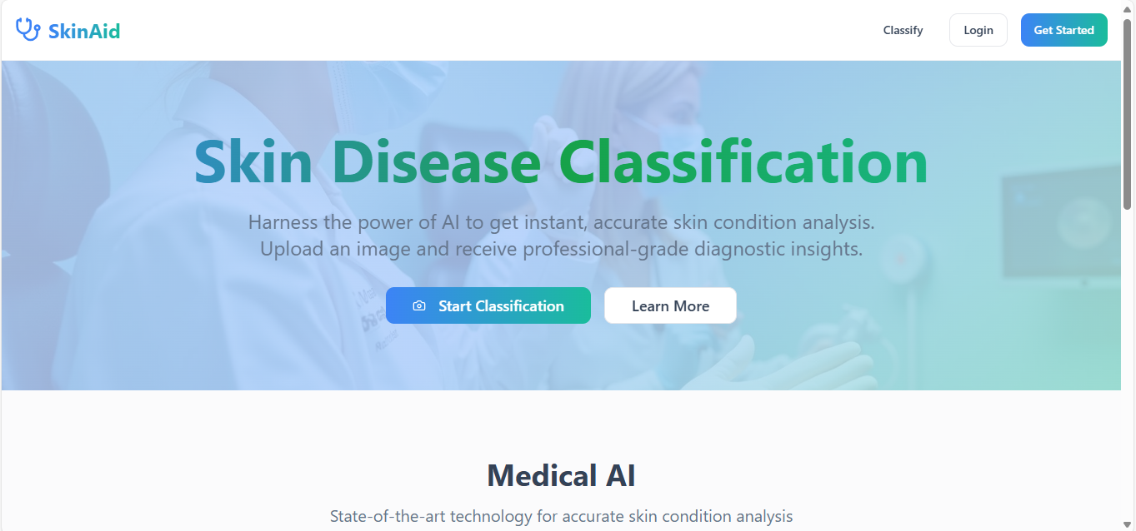
To classify skin diseases from input images.
Implementation
Notes:
11

Slide 12
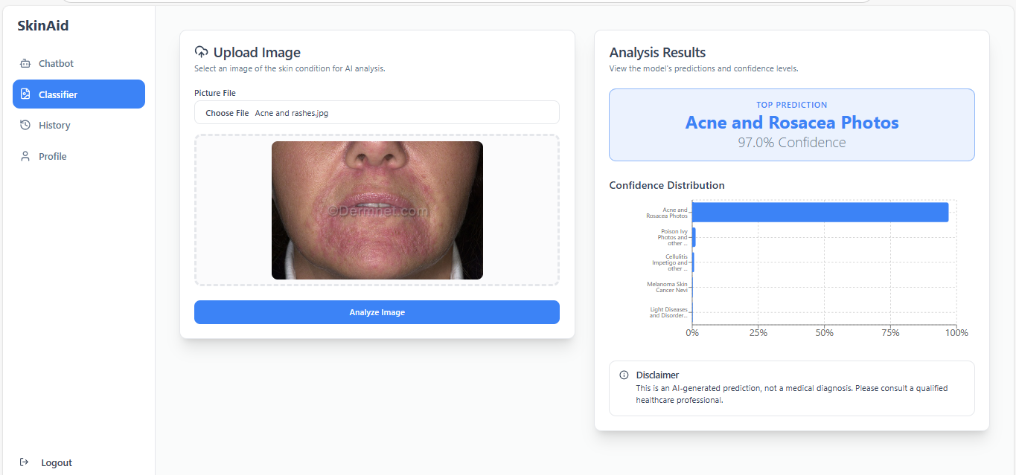
To classify skin diseases from input images.
Implementation
Notes:
12

Slide 13
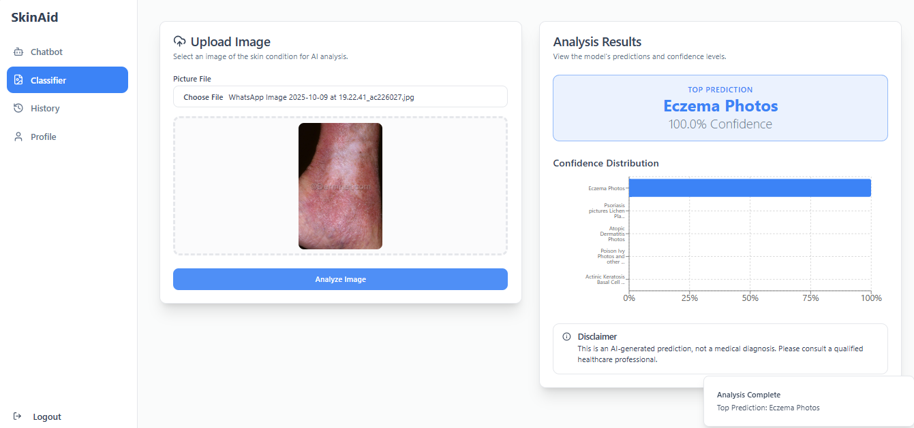
Implementation

Slide 14
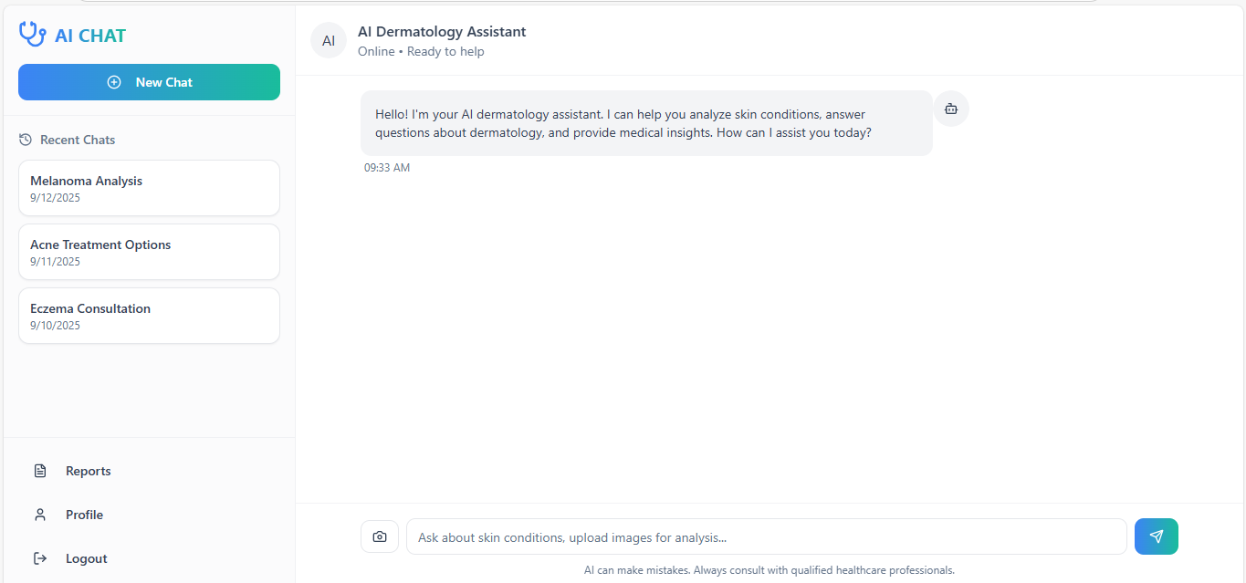
To classify skin diseases from input images.
Implementation
Notes:
14

Slide 15
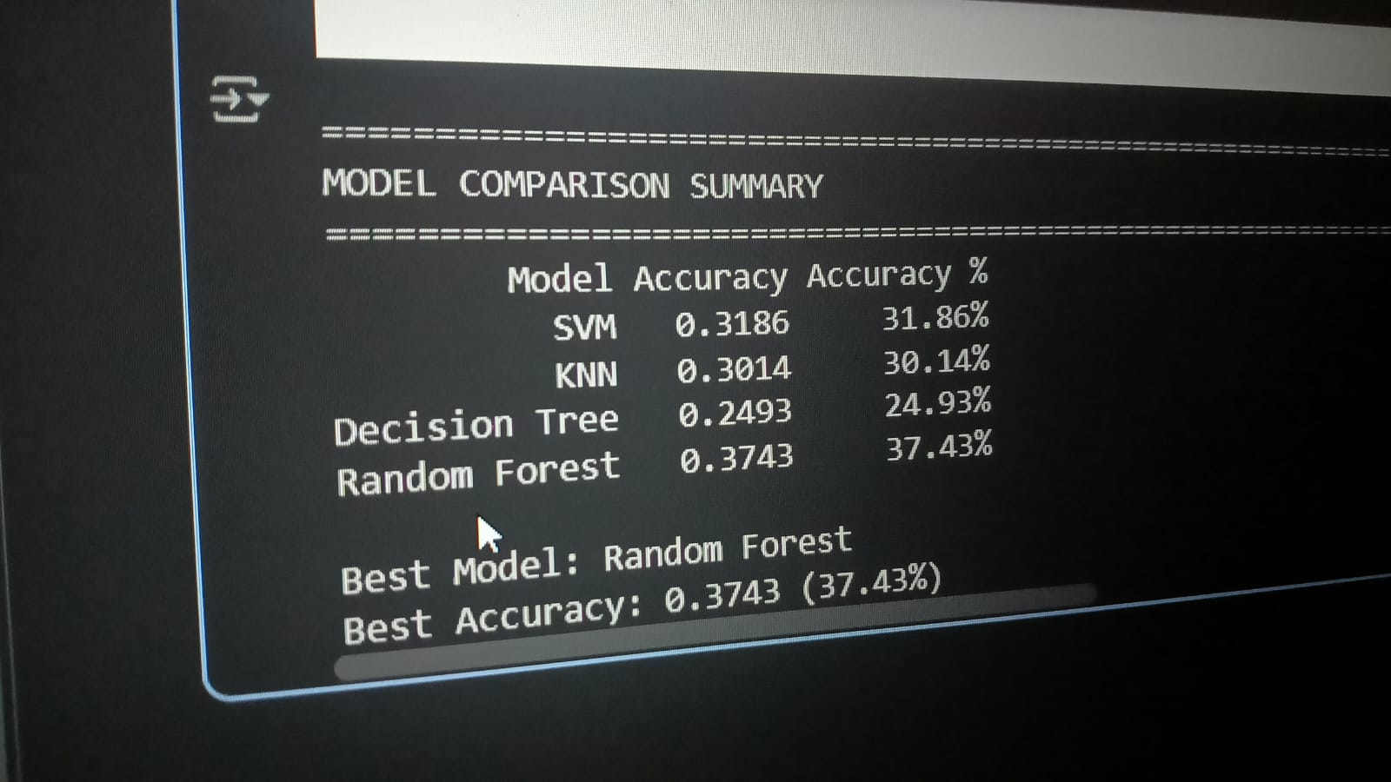
Previously Tested Models

Slide 16
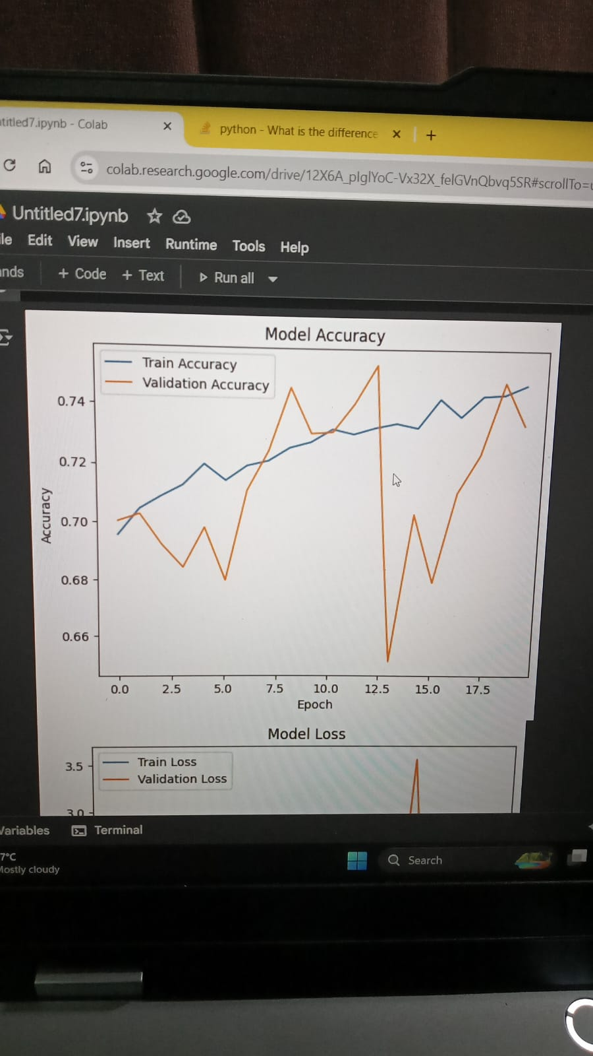
Previously Tested Models

Slide 17
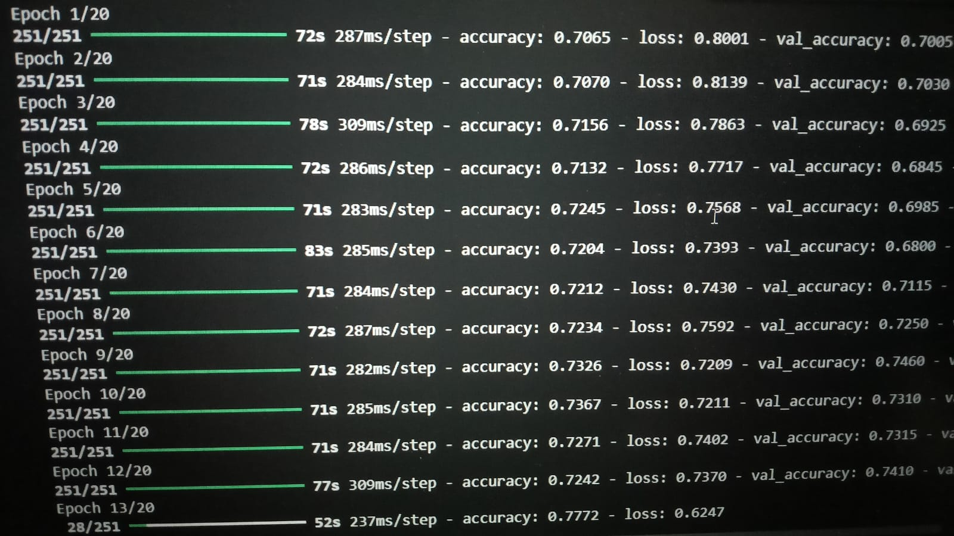
Previously Tested Models

Slide 18
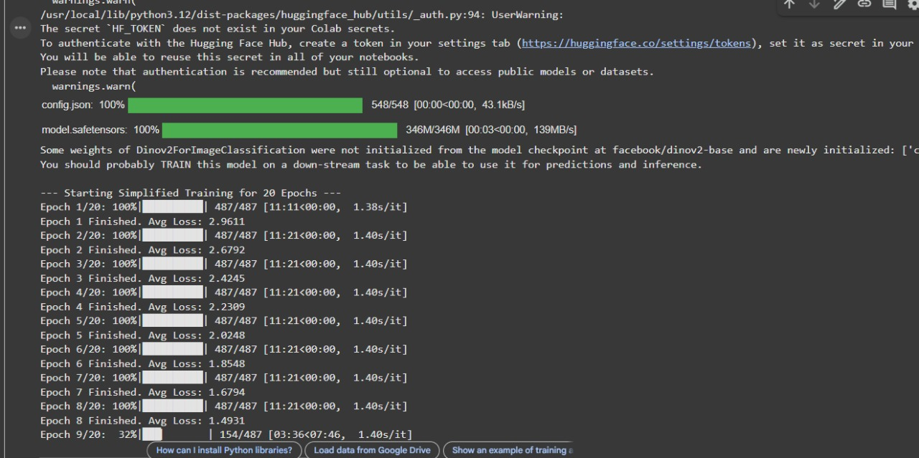
Previously Tested Models

Slide 19
Conclusion
The SkinAid project successfully delivered a high-accuracy, transparent skin disease classifier using deep learning (CNN) integrated into a robust full-stack application (React/FastAPI). It met all goals, offering statistically significant diagnostic efficacy and building user trust via the Grad-CAM explanation feature and an integrated support chatbot for post-diagnosis guidance

Slide 20
Future Scope
The SkinAid project's future aims to boost diagnostic fairness and utility. Key steps include training with Fitzpatrick skin type data and enabling multiple lesion detection. Feature enhancements involve integrating chatbot symptom data for multi-modal diagnosis and adding risk prediction. Deployment will scale with a native mobile app and cloud-native microservices

Slide 21
THANK YOU !
Notes:
21

